Slide 1

Exam AZ-304: Microsoft Azure Architect Design Crash Course
Tim Warner

Slide 2


Tim Warner
Based in Nashville, TN, US
MCT, MVP
Twitter: @TechTrainerTim
Badge: timw.info

Slide 3
Course Materials
timw.info/az304

Slide 4
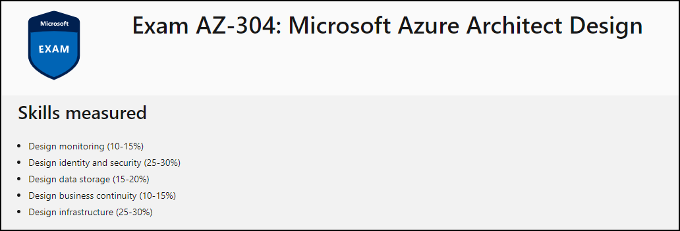
Learning Goals

Slide 5
Session 1
Design identity and security
Design data storage
Design monitoring

Slide 6
Session 2
Design business continuity
Design infrastructure
Azure Architect certification prep tips and tricks

Slide 7
Setting Expectations
Azure Architect is an expert-level certification
You should already know how to deploy and configure Azure resources
This is a "crash course"
Please plan to review these materials more than once
Recording takes ~24 hours to process
Five-minute break at midpoint
Please ask/answer questions and provide feedback in the Q/A panel, not the group chat

Slide 8

Course Recordings

Slide 9

Course Recordings

Slide 10
2020 Exam Update Information
Microsoft Worldwide Learning (WWL) revisits the Azure role-based certs yearly
Relevant blog post: timw.info/az2020
AZ-304 is available now
AZ-301 retires around September 30, 2020

Slide 11
Tim's Certification Study Pyramid
Interdependence
Content knowledge
Practical application
Test-taking skills

Slide 12
Authentication

Slide 13

Tenant vs. Subscription

Slide 14

Hybrid Identity

Slide 15

Passthrough Authentication

Slide 16

Seamless Single Sign-on

Slide 17
Authorization and Governance

Slide 18

Azure Management Scopes
/ Tenant Root

Slide 19
Azure Storage

Slide 20
Storage Account Replication
1
3
3
2
LRS
ZRS

Slide 21
Storage Account Replication
3
3
GRS/RA-GRS

Slide 22
Storage Account Replication
1
3
1
3
2
2
GZRS – RA/GZRS

Slide 23

Always Encrypted

Slide 24

Data Pipelines

Slide 25
Monitoring

Slide 26

Azure Diagnostics

Slide 27

Log Analytics

Slide 28

Sentinel

Slide 29
Exam AZ-304 Item Types

Slide 30

Multiple Choice

Slide 31
Repeated Scenario
You need to move an Azure VM to another hardware host.
Solution: You redeploy the VM.
Does this solution meet the goal?
Yes
No

Slide 32

Select and Place

Slide 33

Build List and Reorder

Slide 34

Active Screen/Fill in the Blank

Slide 35

Case Study

Slide 36






Performance-Based Lab

Slide 37
Microsoft Online Testing

Slide 38
Microsoft Online Testing Process
timw.info/online

Slide 39

Microsoft Online Testing Process

Slide 40

Microsoft Online Testing Process

Slide 41

Microsoft Online Testing Process

Slide 42

Microsoft Online Testing Process

Slide 43

Microsoft Online Testing Process

Slide 44

Microsoft Online Testing Process

Slide 45

Microsoft Online Testing Process

Slide 46
AZ-304 Exam Strategy
Focus your skills accordingly:
60 percent Azure portal
20 percent Azure PowerShell
10 percent Azure CLI
10 percent KQL
Expect performance-based labs, but be thankful if you don't see 'em

Slide 47
Thank you!
Course materials: timw.info/az304
Twitter: @TechTrainerTim
Work: timw.info/ps
Web: TechTrainerTim.com

Slide 48
Migration and Disaster Recovery

Slide 49
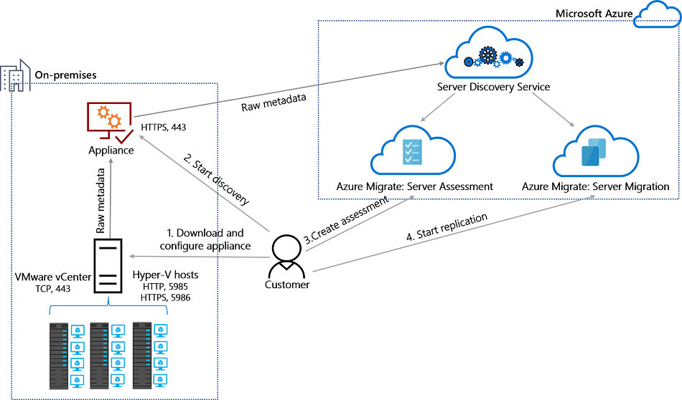
Azure Migrate

Slide 50

Azure Backup

Slide 51

Azure Site Recovery

Slide 52
Azure Compute

Slide 53
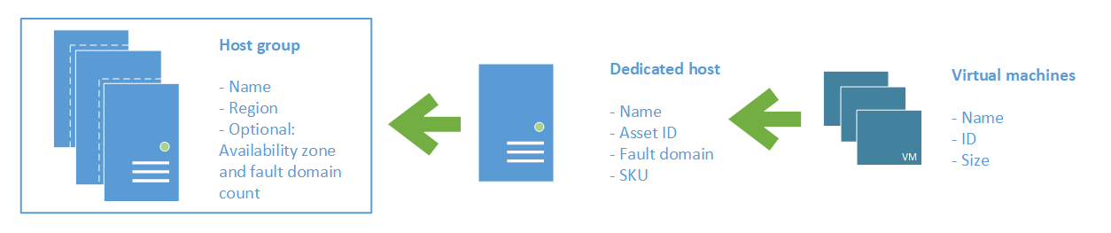
Azure VM Dedicated Host

Slide 54
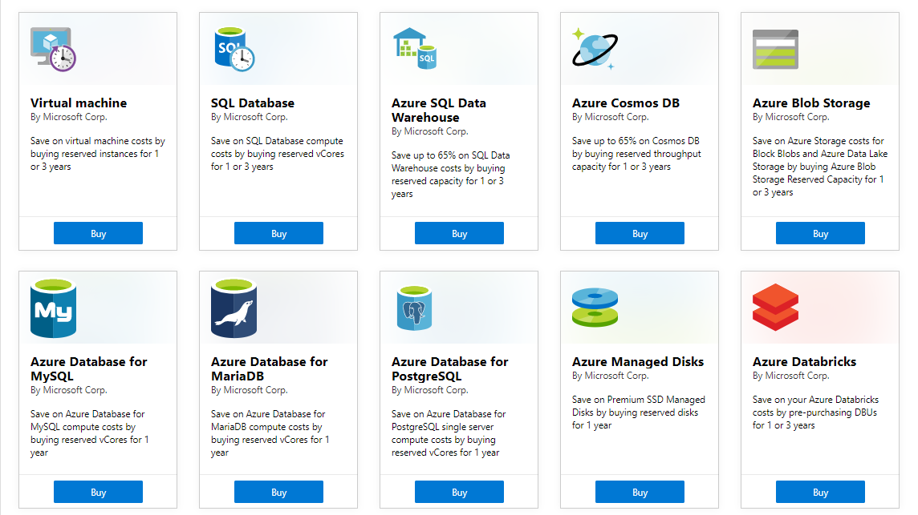
Azure Reservations

Slide 55

VM Scale Sets

Slide 56
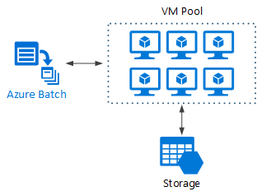
Azure Batch

Slide 57

Availability Set

Slide 58

Availability Zone

Slide 59
Load Balancing

Slide 60

VM Networking

Slide 61

Load Balancing

Slide 62

VNet Peering

Slide 63

Hybrid Networking

Slide 64

Network Virtual Appliance

Slide 65

Azure Load Balancer

Slide 66

Application Gateway

Slide 67

Traffic Manager

Slide 68

Front Door Service

Slide 69
Governance

Slide 70
Tenant vs. Subscription

Slide 71
Azure Management Scopes
/ Tenant Root

Slide 72
App Architecture

Slide 73


Docker Container Lifecycle
https://timw.info/3635f

Slide 74

Event Architecture

Slide 75
Data Platform

Slide 76
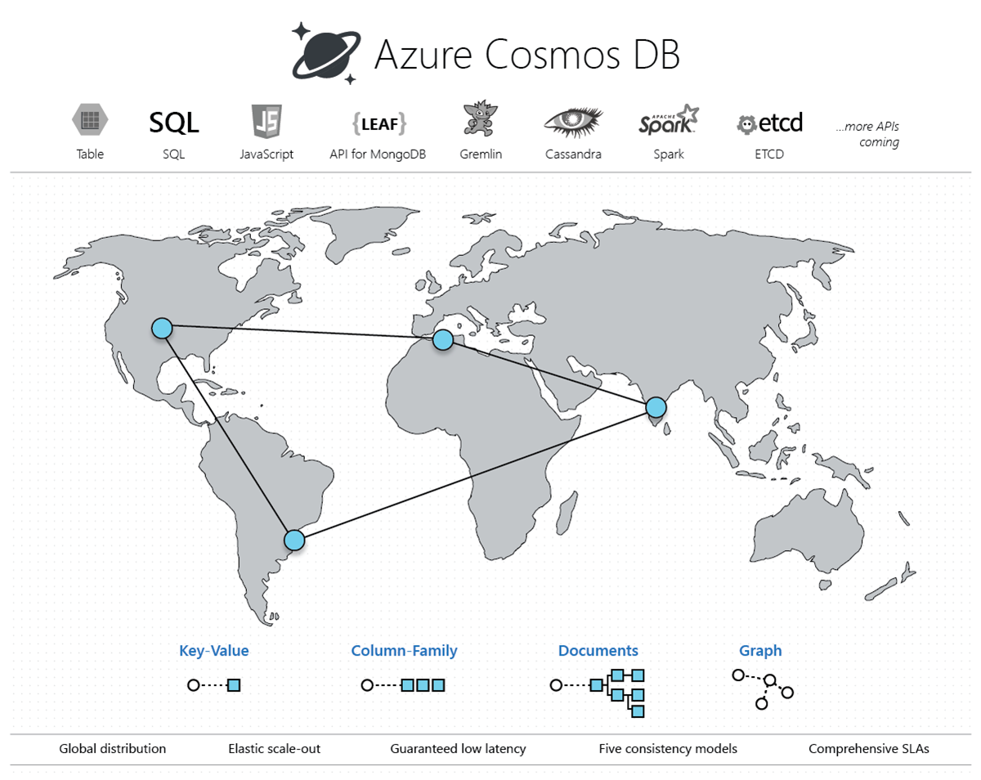
Cosmos DB

